Slide 1


Slide 2
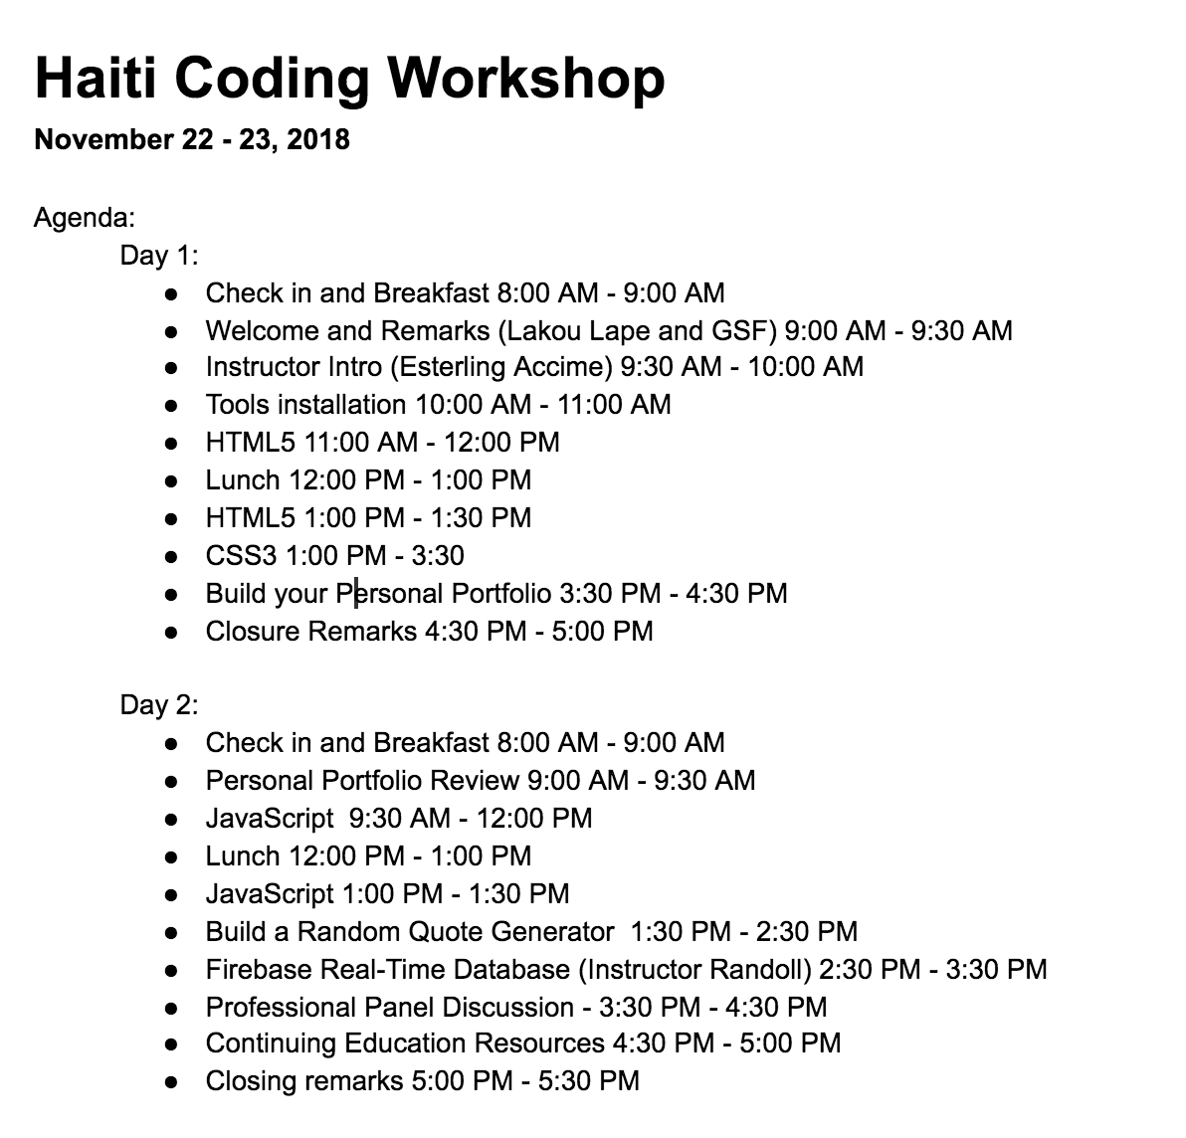

Slide 3
Non Wifi Lan: WIFI Password: acces2018

Slide 4
Prezantasyon(20 segond)
Nom
Zòn
Pouki rezon ou chwazi patisipe nan kou sa?
Notes:
This class is, after all, about you – so let’s do some introductions.
(You may also want to ask “Fears about class?” – that can turn a little negative, so be ready to dissuade/make happy the students if you do ask this)

Slide 5

Esterling Accime
Software Engineer – Cox Automotive
Pwofesè - Georgia Tech Coding Bootcamp
4 experyans
Notes:
Enough about you, time to talk about me.

Slide 6
Pa bliye ke …
Bagay ki bon pa vini fasil
Notes:
There are a few things you can do to ensure your success

Slide 7
Kle pou reyisi…

Slide 8
Pa devni tankou misye…
Notes:
First off, don’t be this guy.
Those that have the hardest time in the program are not the ones who came in knowing no programming.
It’s not the ones who haven’t played around with HTML, CSS, or Javascript.
It’s the ones who walk in thinking they either A) Know more than they do. Or B) Are experts in a completely different field.
There is something that stops people like this from accepting the reality.

Slide 9

Ou sipoze tankou misye.
Notes:
Be this guy. Having a humble attitude is the first requirement of being successful in this program.

Slide 10
Lè’w ap aprann Web Development

Slide 11
Ou pa konn anyen.
Notes:
Don’t be frustrated! Keep an open mind – you’re here to learn.
You mastery of other subjects, educational backgrounds, and professional successes do not guarantee that you will do well here. The only thing that will guarantee success is hard work, humility, and a relentless desire to be better.

Slide 12
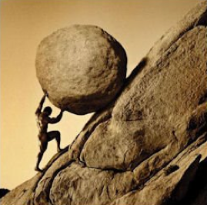
Ide pou 2 jou Haiti Coding Workshop
Toujou sonje ke ou sipoze
Travay di!!

Slide 13
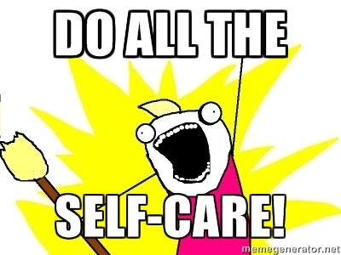
Ide pou 2 jou Haiti Coding Workshop
Toujou sonje ke ou sipoze
Travay di!!
Apresye siksè’w

Slide 14

Ide pou 2 jou Haiti Coding Workshop
Toujou sonje ke ou sipoze
Travay di!!
Apresye siksè’w
Kwè nan tèt
Notes:
Questions?

Slide 15
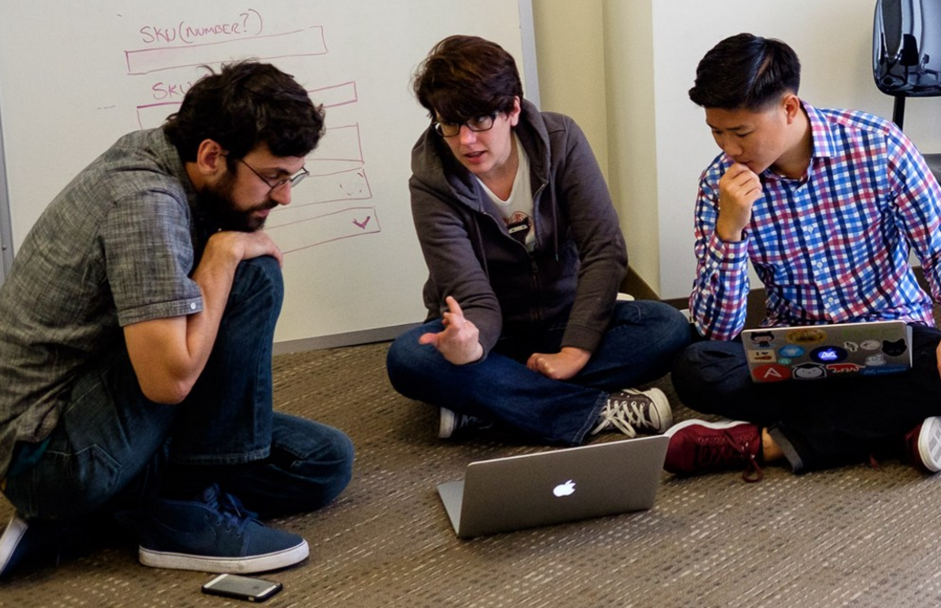
Men sonje ke…
Si’w vle ale rapid, ale pou tèt ou. Si’w vle ale lwen, ale an ekip

Slide 16

Google Fu – Pi enpòtan konpetans ke’w genyen
Kisa ki Google Fu?
Notes:
Of course, to do this, you’ll need to be great at googling!
This is arguably the best/most important skill you can use.
It’s silly, but being able to find the answers to your questions is extremely important, and people won’t always be around. Google should almost always be your first go-to (it has almost every answer, if you know how to find it).

Slide 17
Objektif pou Jodi an
Etidyan dye pratike anpil HTML.
Edityan pral komanse aprann itilize senp HTML tag.
Etidyan pral aprann aplike CSS nan HTML yo

Slide 18
HTML5

Slide 19
Sentaks HTML
Kontni
<h1>
Sa se kay Matye an
</h1>
Ouvèti Tag
Fèmen Tag

Slide 20
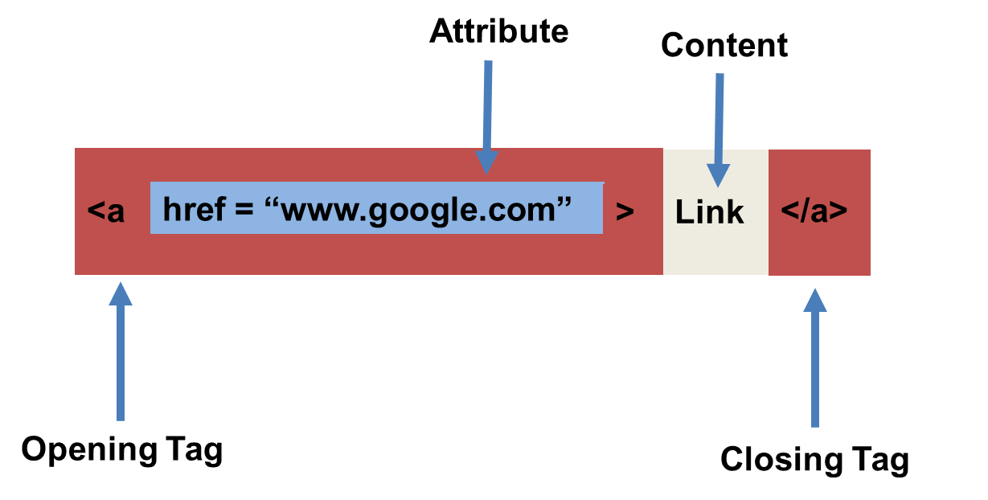
Sentaks HTML (avèk atribi)

Slide 21
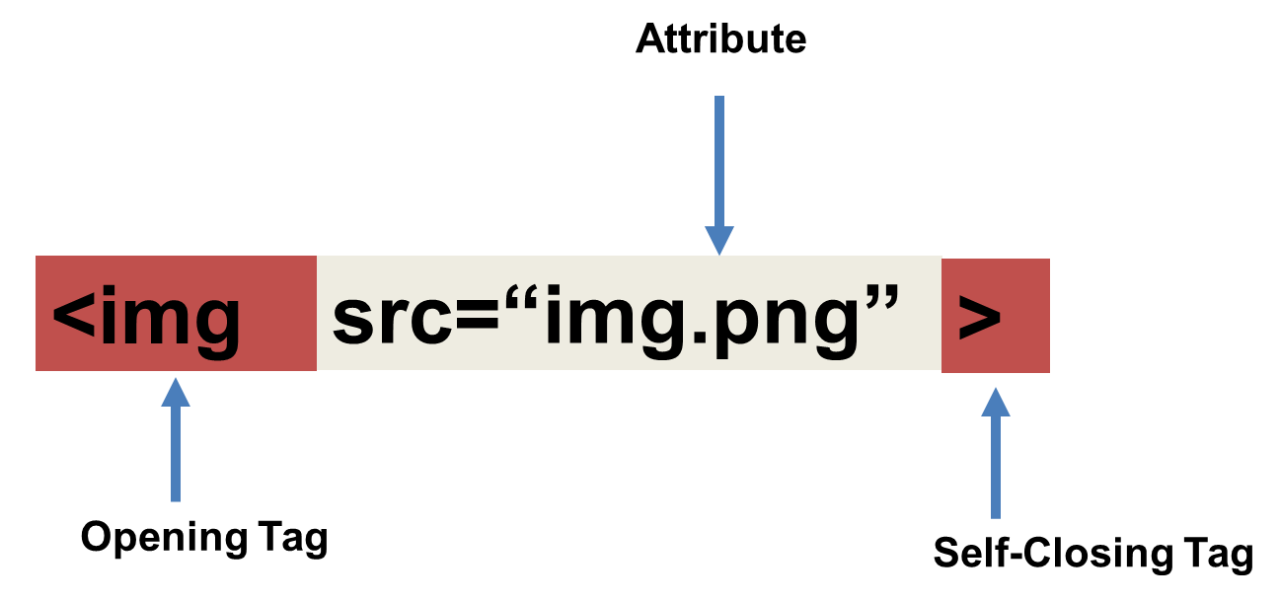
Tricky Tags (Self-Closing)

Slide 22
Tags ki enpòtan (Souvan itilize)
Headings:
<h1> </h1> - Tit 1 (Tit ki pi laj laj)
<h2> </h2> - Tit 2 (Dezyèm tit li laj)
<h3> </h3> - Tit 3
…
Containers:
<html> </html> - Vlope tout paj lan
<head> </head> - Vlope tèt paj lan
<body> </body> - Vlope Kontni prensipal lan
<div> </div> - Kontni lojik yo
<p> </p> - Vlope paragraph endividyèl
Lòt:
<strong> (fonse), <em> (anfaz)
<img> (imaj), <a href> (lyen), <li> (lis atik yo) , <title> (tit), <br> (liy kraze), <table> (tab), <!-- --> (komantè)

Slide 23
Tags ki pa two popilè
Ou kapab jwenn tout tags HTML yo sou sit sa. http://www.w3schools.com/tags/
Pa eseye memorize yo. Senpleman refere avèk yo nan dokiman an lè’w bezwen.
Lòt tags:
<video> Pou Videos
<audio> Pou fichye Audio
<embed> for fichye Embedded
<code> Pou inkli Kòd Òdinatè.
<header> Pou tèt lan
<nav> Pou navigasyon ba yo
<footer> Pou pye yo

Slide 24
Fòm HTML
<form> - Kreye yon seksyon pou fòm HTML ou.
<input> - Bwat opinyon
<label> - Etikèt bwat ou
<button> - Bouton
<textarea> - Gwo bwat tèx ou

Slide 25
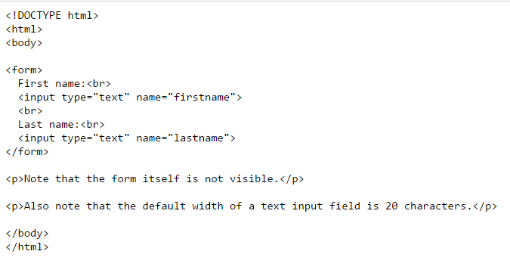
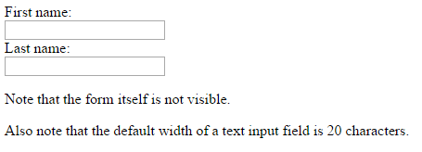
HTML for Forms

Slide 26
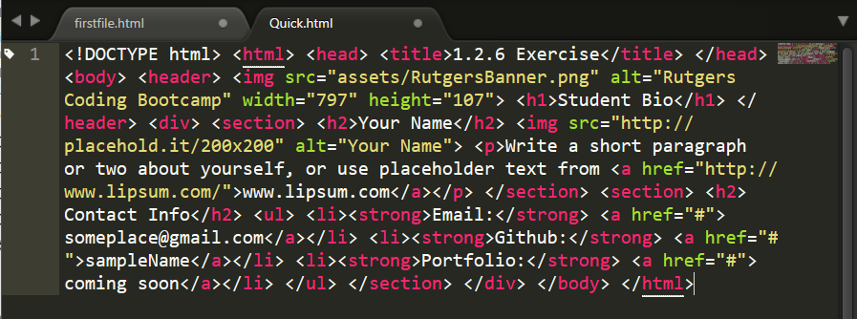
Yon HTML ki lèd
Pa fè sa. Itilize bonjan endantasyon
Fòk kòd fasil pou lòt moun lil.
Envesti tan’w pou’w evite ekri kòd ki sanble avek sa ki nan imaj lan.

Slide 27
> Tou pa’w!
Tan: 20 min
Egzèsis
Kreye yon senp paj HTML avèk enfòmasyon'w ki sanble avèk imaj sa.

Slide 28
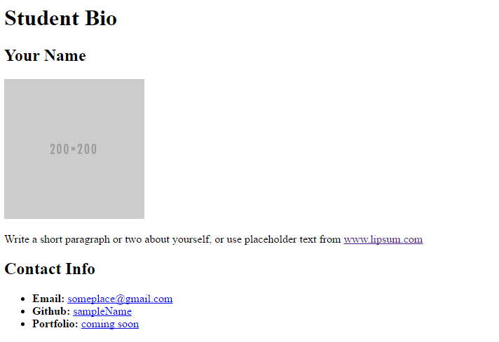
> Tou pa’w!

Slide 29
CSS

Slide 30


HTML / CSS Definisyon
HTML: Hypertext Markup Language – (Kontni)
CSS: Cascading Style Sheets – (Aparans)
HTML/CSS se ”langaj web lan”. Ansanm, yo fòm define kontni avek estetik yon paj web – yo manyen tout bagay komanse sou layouts, koulè, fonts, e menm plasman de kontni (JavaScript se 3èm – li manyen lojik, animasyon paj lan. )

Slide 31
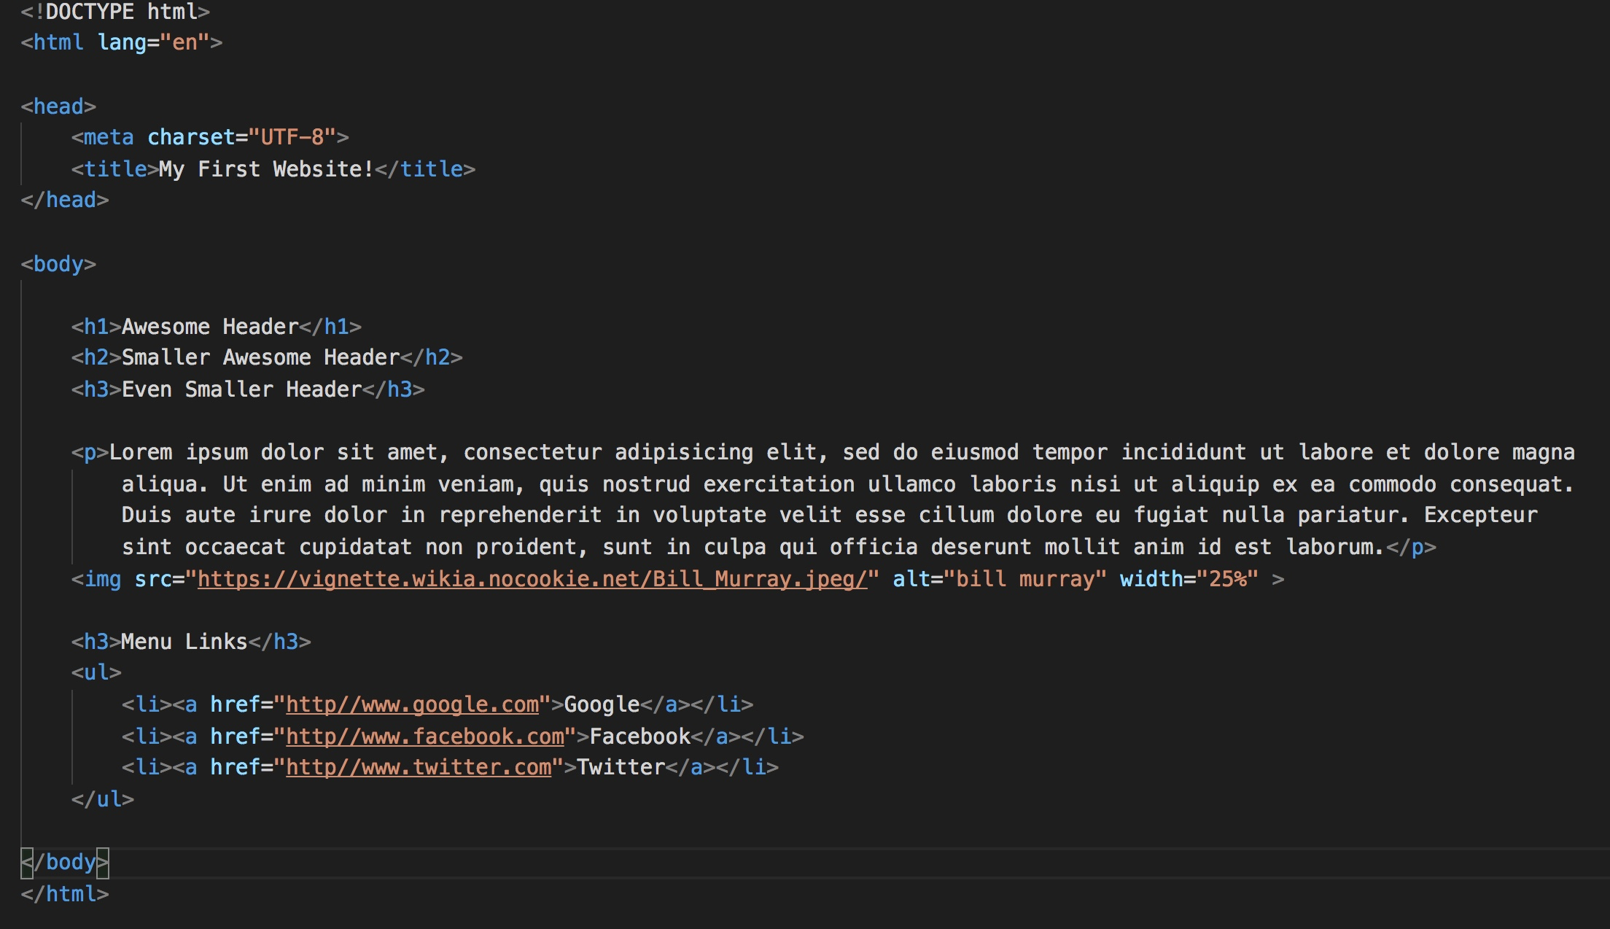
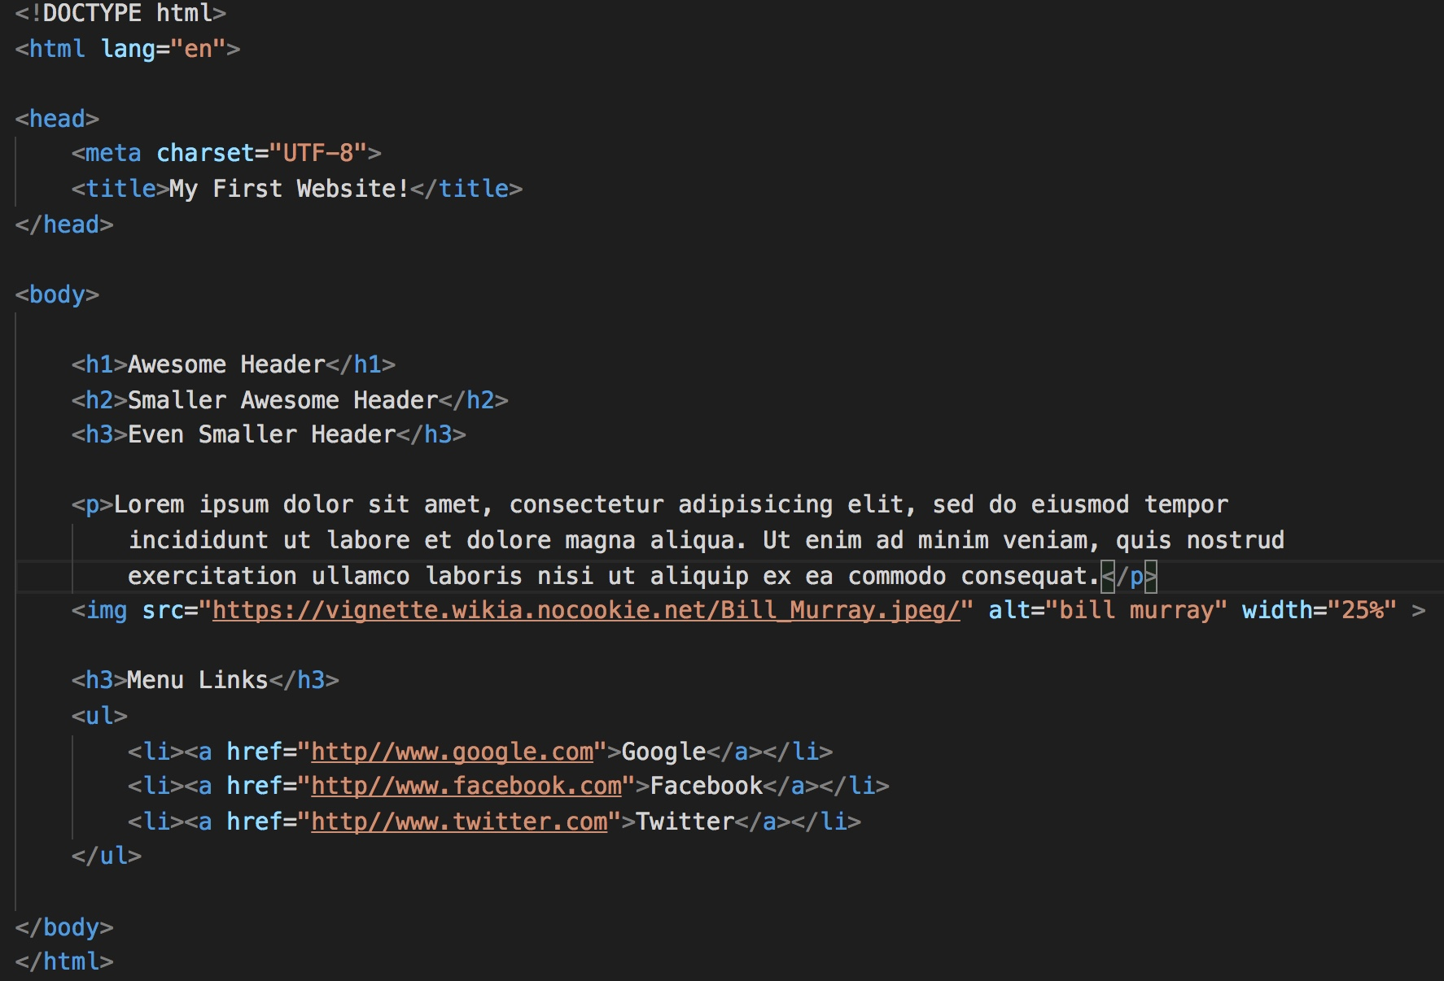
Yon senp paj HTML

Slide 32

Rezilta senp paj HTML lan

Slide 33
Rezilta Senp paj HTML lan
Paj sa raz…

Slide 34
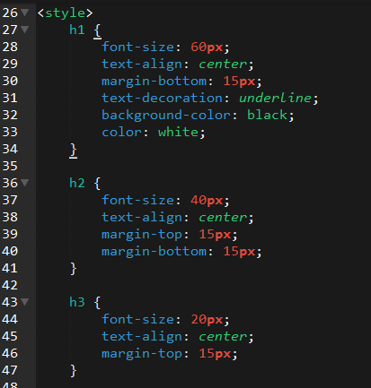
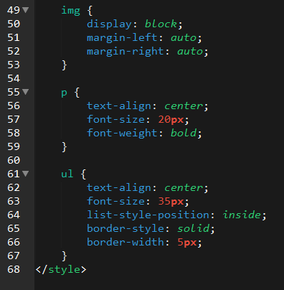
Ajoute kèk css

Slide 35

Rezilta CSS

Slide 36

CSS Sentaks
CSS fonksyone se lè’w akroche css selector anndan HTML an itilizan class oswa ID.
Lè’w finn akwoche selector yo, nou aplike style nan eleman HTML yo an itilizan CSS.

Slide 37
Kle kèk CSS Atribi
Font / Color:
color: Change koulè yon text
font-size: Chanje gwosè text lan.
font-style: Fèl italik.
font-weight: Fèl fonse
aliyman / Espas:
padding (top/right/bottom/left): Ajoute espas antre eleman yo
margin (top/right/bottom/left): Ajoute espas antre eleman yo avek tout sa ki antoure yo.
Background:
background-color: Chanje koulè background lan.
background-image: Chanje imaj background lan.

Slide 38
Pwisans HTML5/CSS3
Kwèl ou pa, ou kapab bati yon bèl sit avèk HTML5/CSS3

Slide 39
DEMO
Pwofesè: Demo

Slide 40
> Tou pa’w!
Tan: 20 min
Egzèsis
Nan aktivite sa. Wap pran premye aktivite an, wap itilize kèk CSS pou’w akonpli sa ki nan imaj lan.

Slide 41
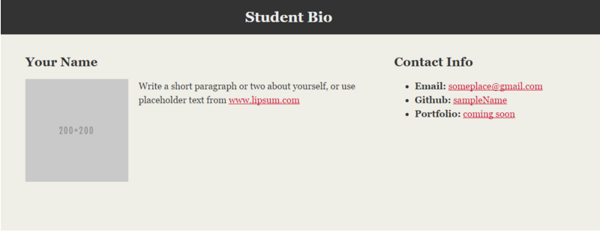
> Tou pa’w!

Slide 42
Kesyon

Slide 43

Break!

Slide 44
Chemen Fichye Relatif

Slide 45
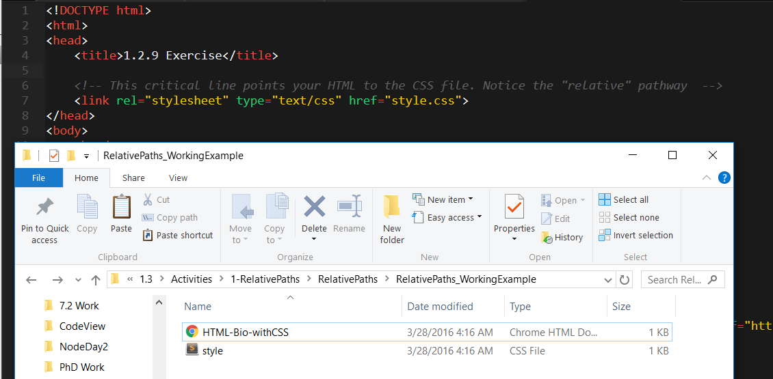
Chemen Fichye Relatif
Chemen fichyen relative: Konekte avek lot fichye sou òdinatè an. Nan examp sa, fichye style lan nan menm folder avek HTML-Bio-withCSS lan.

Slide 46
Demo
Pwofesè: Demo

Slide 47
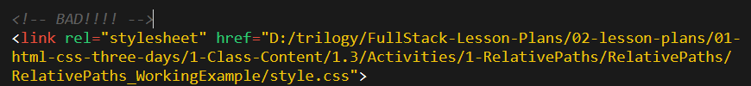
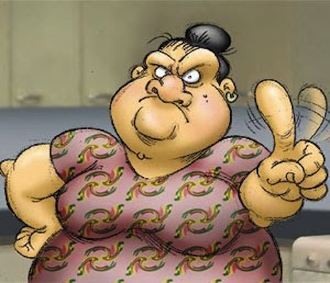
Pa itilize chemen absoli
Trè trè mal
Toujou itilize chemen relatif
Si ou deplwaye sit ou san yo menm, lyen yo pap fonksyone
Menm bagay lan ap pase si’w move folder nan lot kote sou òdinatè’w.
Sonje ke sou internet, pa gen bagay ki “C:” drive sou li.

Slide 48
> Tou pa’w!!
Tan: 15 min
Egzèsis
Itilize chemen relatif pou'w konekte HTML avek CSS nan chak folder.

Slide 49
Flexbox

Slide 50

Layout

Slide 51
Demo
Pwofesè: Demo

Slide 52
Kesyon?

Slide 53
CSS Resets

Slide 54

Loading Multiple CSS Files ***(Very Important!!!)***
We can link our documents to more than one stylesheet at a time—one of the most powerful features of CSS/HTML.
By tapping into different stylesheets simultaneously, we can create complex layouts with plenty of design rules.
Just remember: the loading order matters!!!

Slide 55
What Browser?
By a show of hands…
Which browser do you use?

Slide 56

Battle of the Browsers
Under the hood, web browsers often render webpages differently than their competition.
These disparities could mean HTML/CSS displaying differently in each web client.
Because of these potential divergences, web developers need to make their websites cross-browser compatible.

Slide 57

Reset.css (or Normalize.css)
Reset.css will “reset” all browser-specific CSS. This means your site will appear the same in all browsers.
However, you will have to re-style everything yourself.

Slide 58
Why CSS Resets Matter
It’s important for creating browser-compatible websites.
It’s an example of using someone else’s CSS in your website!!!
It’s a common Front-End Developer Interview question.

Slide 59
> YOUR TURN!!
Assignment
Follow the instructions given via Slack to incorporate a reset.css file in a basic HTML file.
Note the impact of the reset file makes after you include it.

